Slide 1
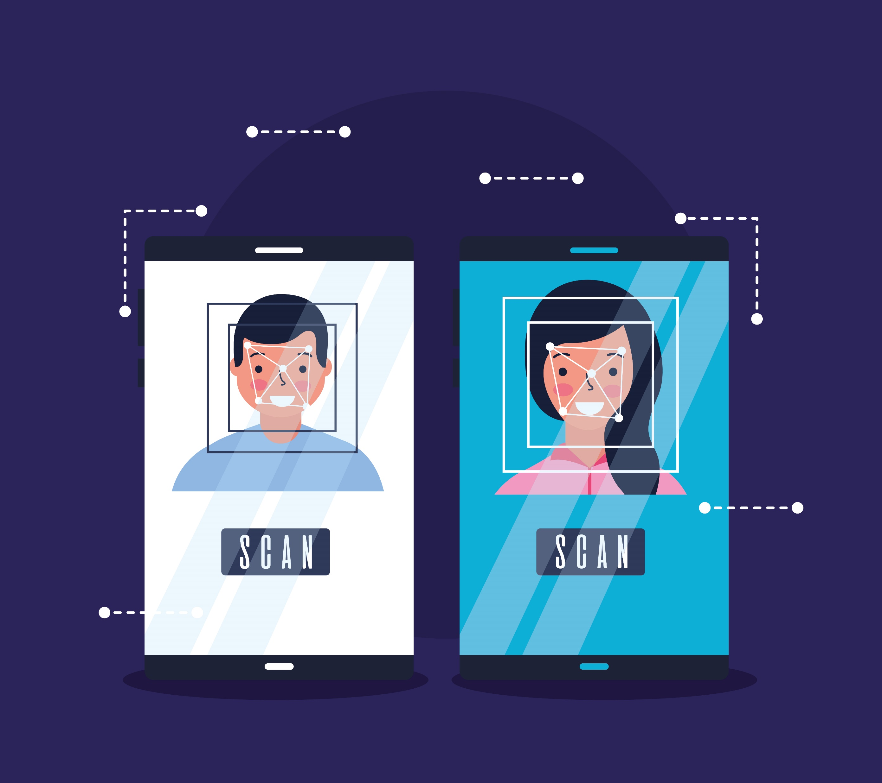
Web based facial authentication system
Guided by:-Rakesh.R(M.Sc)
Presented by:-Sandhya.G

Slide 2
Abstract
Web-based facial authentication systems have gained significant attention as an effective method for user authentication and access control.
In this final year project, we propose the development of a web-based facial authentication system that utilizes facial recognition technology to verify and authenticate users.
The system aims to provide a secure and convenient method for user authentication, eliminating the need for traditional password-based systems.
By leveraging the power of deep learning and computer vision algorithms, the project ensures accurate and reliable facial recognition capabilities.
The project encompasses various modules that collectively contribute to a comprehensive and user-friendly facial authentication system. However, it is essential to consider the limitations of the project, such as potential challenges in handling variations in lighting conditions, pose, and occlusions, as well as the ethical considerations regarding data privacy and user consent.

Slide 3
Introduction
The web-based facial authentication system project aims to develop a secure and convenient method for user authentication by leveraging facial recognition technology. By capturing and analyzing facial features, users can easily authenticate themselves without traditional password-based systems. The project focuses on providing a user-friendly web interface and seamless integration into existing applications.

Slide 4
Requirements
Hardware
226 GB storage
4GB Ram
i3 Processor
Web camera or Webcam
Software
Text Editor:-Visual Studio code
Operating System:-Windows 10
Programming Languages
Python
HTML
CSS
JavaScript

Slide 5
Modules
Image Acquisition: Responsible for capturing facial images using a web camera or allowing users to upload images for authentication.
Preprocessing: Enhances image quality, eliminates noise, and prepares images for feature extraction and recognition.
Feature Extraction: Utilizes deep learning and computer vision algorithms to extract unique facial features from the preprocessed images.
Facial Recognition: Compares the extracted facial features with a pre-registered database of facial features to find potential matches.
Authentication: If a match is found, the user is authenticated, granting access to the system or application.
User Interface: Provides a user-friendly web interface for capturing images, displaying authentication results, and integrating with web applications.

Slide 6
Methodology
We need one programming language to do anything so we use python and to represent the data available in form of graphs we use pandas and then we need to build machine learning model for this we will use scikit module, then we have OpenCv to access your webcam and give information to run your machine learning model.
Programming language and modules used for face recognition model building are:
Python language: Chosen as the programming language for building the face recognition model.
Machine learning modeling: Utilized to develop the machine learning algorithms for the face recognition model.
OpenCV for computer vision: Used to access the webcam and process video frames for face detection and recognition.
Scikit for machine learning algorithm: Leveraged to implement machine learning algorithms for training and predicting faces.
Pandas library for data visualization and cleaning: Employed for data cleaning, preprocessing, and organizing the face recognition dataset.

Slide 7
Features
Secure Authentication: Facial recognition technology offers a robust and secure method for user authentication, eliminating the need for traditional passwords.
Convenience: Users can authenticate themselves simply by their facial features, providing a convenient and user-friendly experience.
Seamless Integration: The web-based nature of the system allows easy integration into existing web applications and systems, enhancing security and user access control.

Slide 8
Advantages / Disadvantages
Enhanced Security: Facial authentication provides a higher level of security by leveraging unique facial features.
Convenience: Users can easily authenticate themselves without the need for passwords or physical tokens.
User-Friendly Experience: Facial authentication offers a seamless and intuitive user experience, improving user satisfaction.
Handling Variations: The system may face challenges in handling variations in lighting conditions, pose, and occlusions, which can affect the accuracy of facial recognition.
Ethical Considerations: Privacy and data protection are critical considerations, and proper consent and security measures must be implemented to protect user data and ensure compliance with legal and ethical requirements.
System Performance: The computational requirements for facial recognition algorithms may impact system performance, and optimization techniques may be necessary for efficient processing.

Slide 9
Result
Successful development and implementation of a web-based facial authentication system.
Accurate and reliable facial recognition capabilities demonstrated through rigorous testing.
Seamless integration into existing web applications and systems, enhancing user access control.
Enhanced security and user experience by eliminating traditional password-based authentication.
Consideration of limitations, such as handling variations and ethical considerations, for future improvements.

Slide 10
Conclusion
The web-based facial authentication system project offers a secure and user-friendly solution for user authentication. By leveraging facial recognition technology and deep learning algorithms, the project ensures accurate and reliable authentication. The system's features, seamless integration, and improved privacy considerations contribute to its effectiveness. However, challenges such as handling variations and addressing ethical considerations should be taken into account for future enhancements. Overall, the project successfully achieves its objective of providing a secure and convenient web-based facial authentication system.

Slide 11


